Slide 1

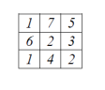
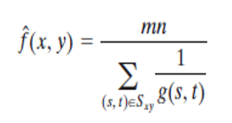
Digital Image Processing
Harmonic mean filter
f (x,y) = 9 / [1/1 + 1/7 + 1/5 + 1/6 + 1/2 + 1/3 + 1/1 + 1/4 + 1/2] = 2.19

